Slide 1
VISUALIZING THE GENDER GAP Gender Gap in the Workforce in East and South Asia
Anjali Sebastian
Kruta Arvind Prabhu
Ulysses Lin
Zachary Jeffreys

Slide 2
- Ruth Bader Ginsburg
“Women belong in all places where decisions are being made... It shouldn't be that women are the exception.”

Slide 3
Motivation
Gender Equality is not only a fundamental right but necessary for society. A visualization that generates awareness of the Gender Gap that exists around the world.
We specifically want to focus on women's ability to participate in the workforce.
Advancing women’s equality could add up to $28 trillion to global annual growth by 2025 according to the McKinsey Global Insititute.
Are societies moving towards greater workforce participation for women?
We hope that the visualization encourages discussion on a very important and sensitive topic.
We hope the visualization is able to communicate both the disparity and significant improvements made.

Slide 4

Audience
Anyone who is a feminist
Anyone who is interested in understanding the Global Gender Disparity

Slide 5
Main Questions
1
2
3
4
What portion of women in the workforce are educated as compared to men?
How is workforce participation changing over time?
How long until we have equal workforce participation?
What sectors (Agriculture, Industry, Services) do women and men work in?

Slide 6
Tools
Design: Paper and Good Notes
Data Cleaning and Wrangling: Python and Tableau
Exploratory Data Visualization: Tableau
Forecasting: Tableau
Code Editor: Visual Studio Code
Version Control: GitHub
Collaborating: Teams and Zoom
D3 for the main visualization
Color Selection: Economist, Adobe Color, Coblis

Slide 7
Data
World Bank
World Bank
World Bank
Working Age Population Statistics (Ages 15 – 64)
Labor Force / Workforce participation Rates (%)
Percentage of workforce that has advanced education
World Bank
Tableau
Key Points
The workforce across Sectors (100%)
Agriculture + Industry + Service
Generating forecast for ratio of participation (Women / Men)
Data is 1990 – 2020
Forecast till 2040
Missing Data
If possible use the last known value

Slide 8
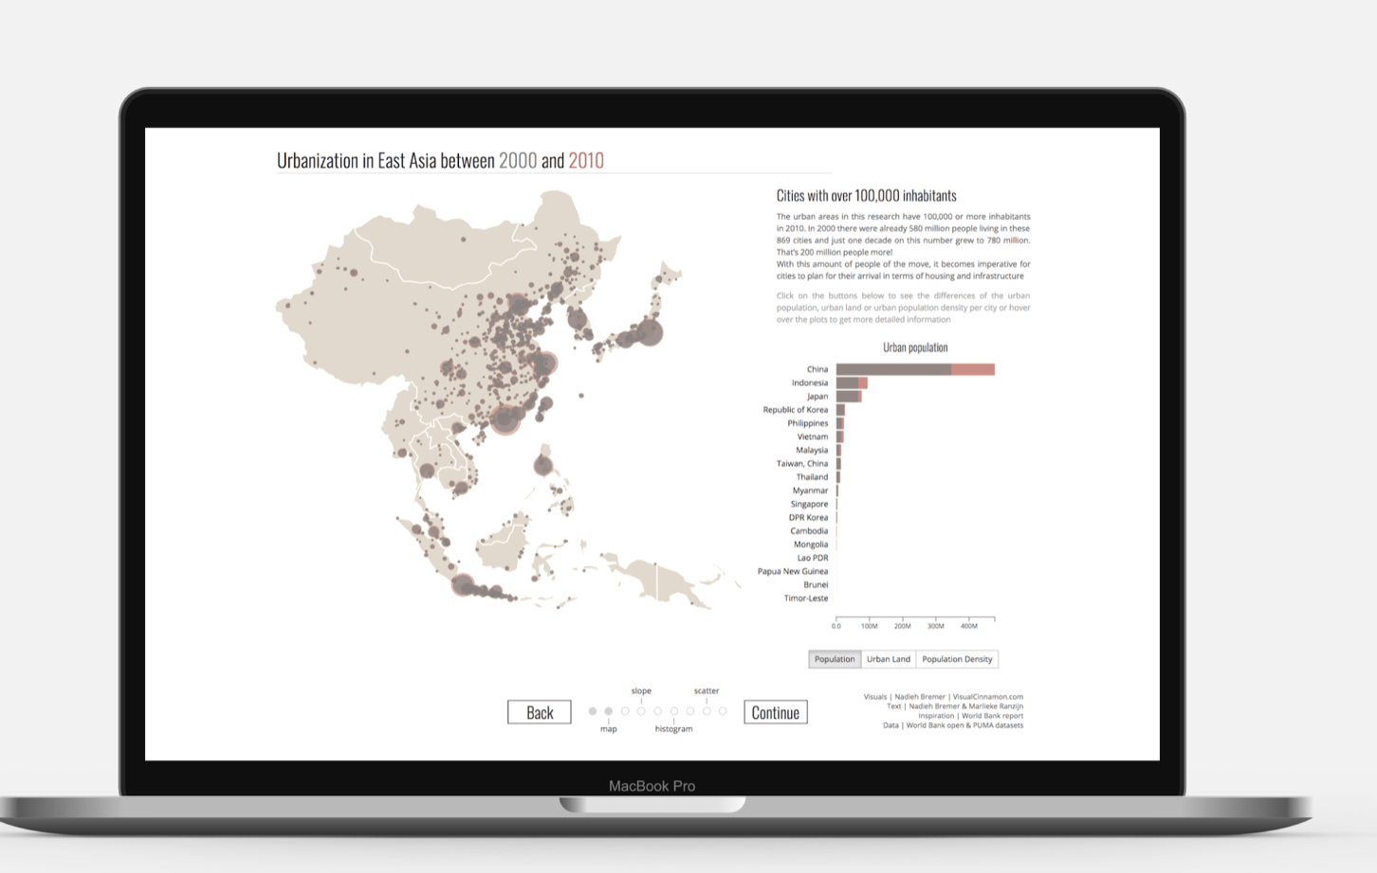
Related Work (1/2)
Similar Design
Inspired by Nadieh Bremer's visualization. Specifically, the dynamic nature of the visualization shows migration over time.
Completely Different Topic
We want to visualize the changing work force participation for women.
https://www.visualcinnamon.com/portfolio/urbanization/

Slide 9
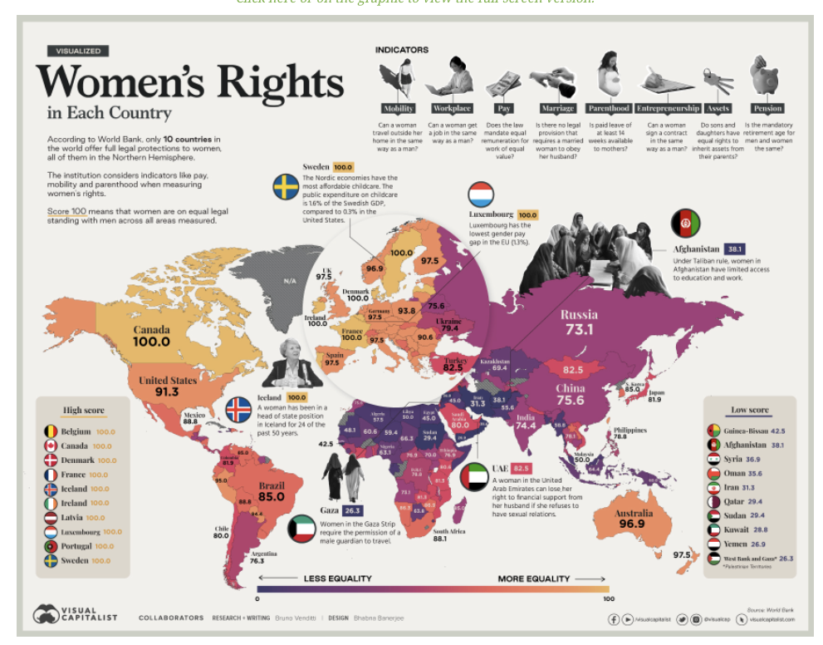
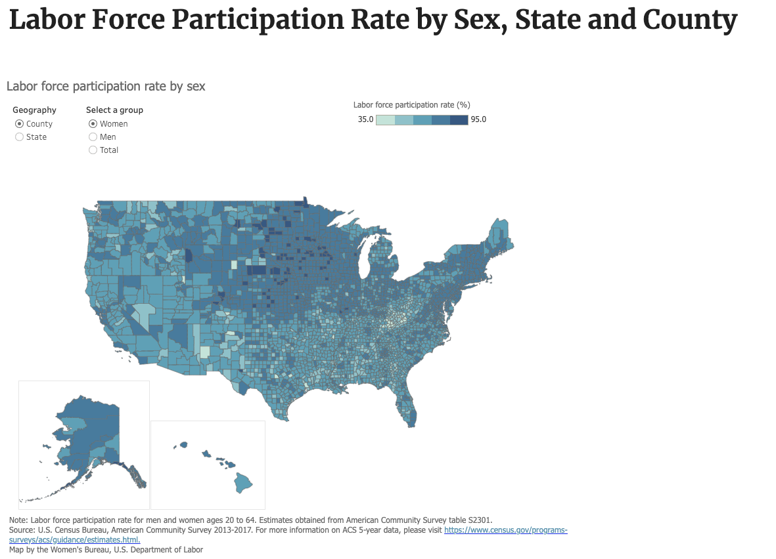
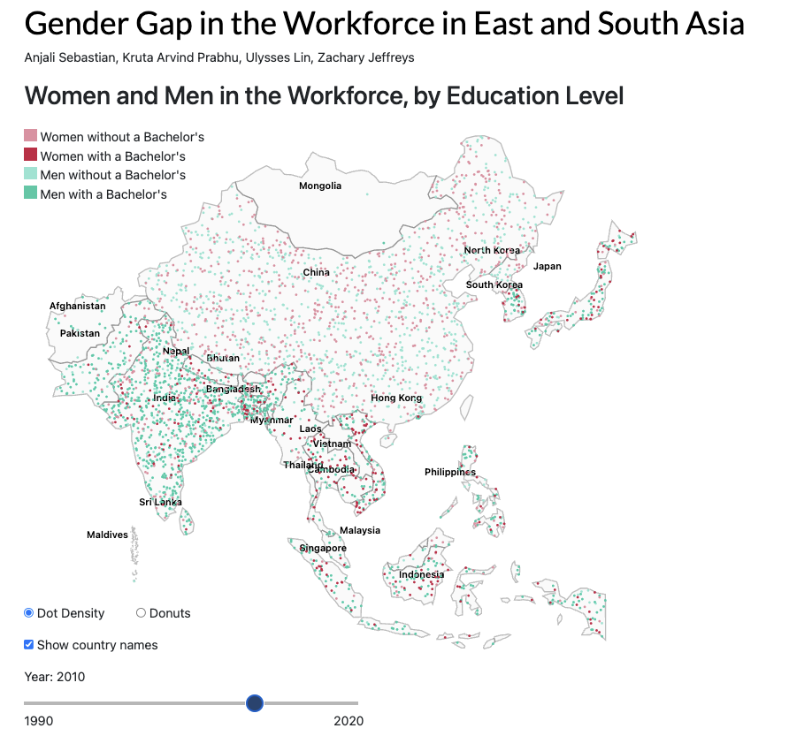
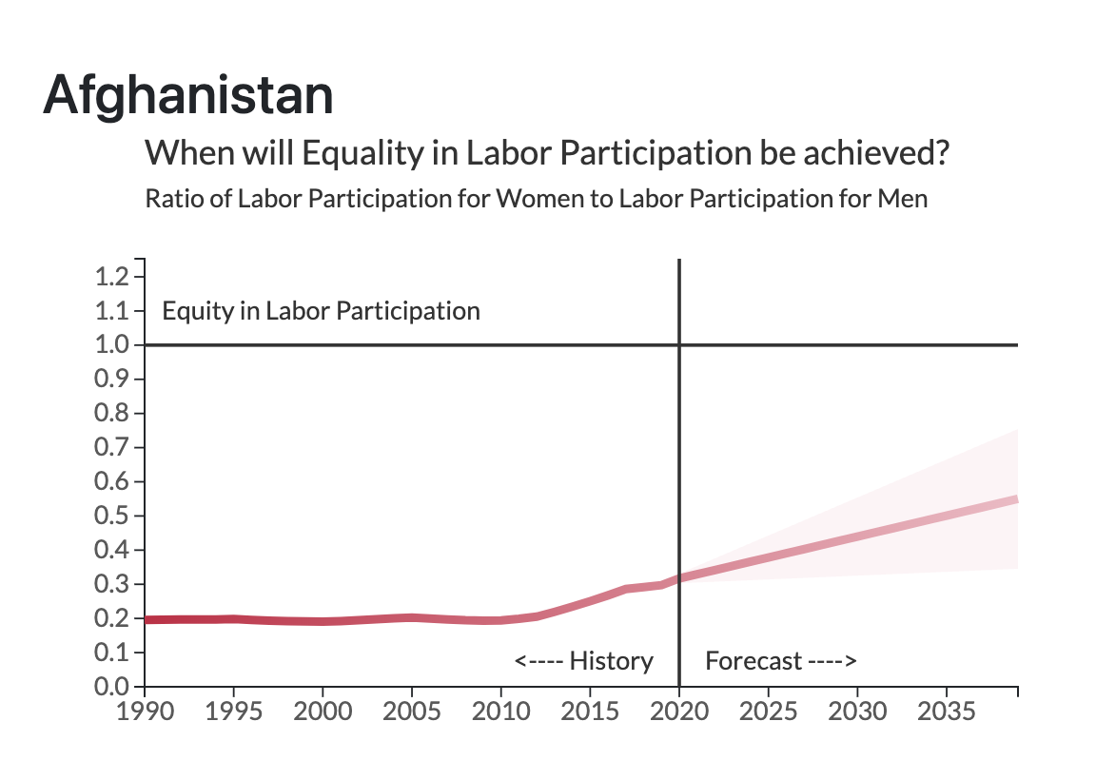
Related Work (2/2)
There are many visualizations of Gender Disparity
We focus on only Workforce Participation in Asia
Almost all use some form of static Choropleth Map we use a Dynamic Dot Distribution
We want to show how many women are joining or leaving the workforce by headcount.
Forecasting to see when the equity in workforce participation rates will be reached.

Slide 10

DEMONSTRATION
Link to GitHub: https://github.com/UlyssesLin/world_bank
Link to the CSS server: http://css1.seattleu.edu/~cs5320-final-g2/

Slide 11
Design Rationale (1/3)
Single region of focus: For better visibility we have chosen two regions: South Asia and East Asia. Seen significant change. Diverse countries with different incomes.
Single topic of focus: Narrowed down the data to find more meaningful insights
Dynamic map that shows women and men who are working with and without advanced education (Bachelor's Degree) from 1990-2020.
Toggle between two map styles: Dot Distribution Map (overall trend) and Donut Map (specific break-down of workforce) to show different aspects of data.
Why Dot Distribution Map ? Unique. See actual headcount representation changing with each year. Better to see global color trend over time.

Slide 12
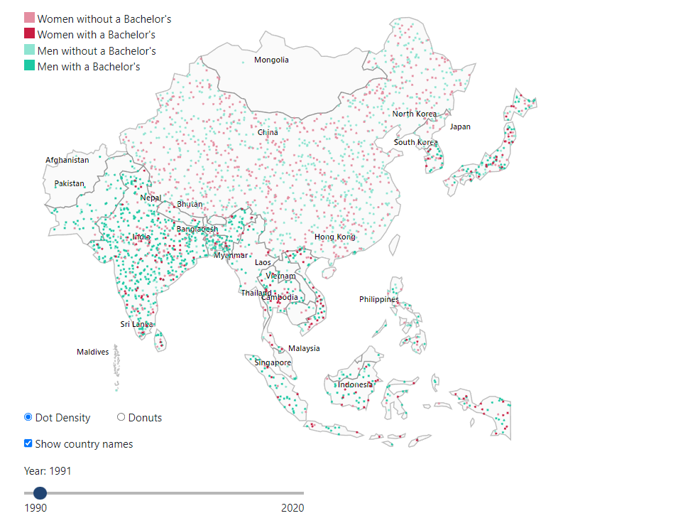
The Dot Distribution Map
Map displaying all Asian countries with the employment for males and females by a degree in the year 1991 using a dot distribution chart

Slide 13
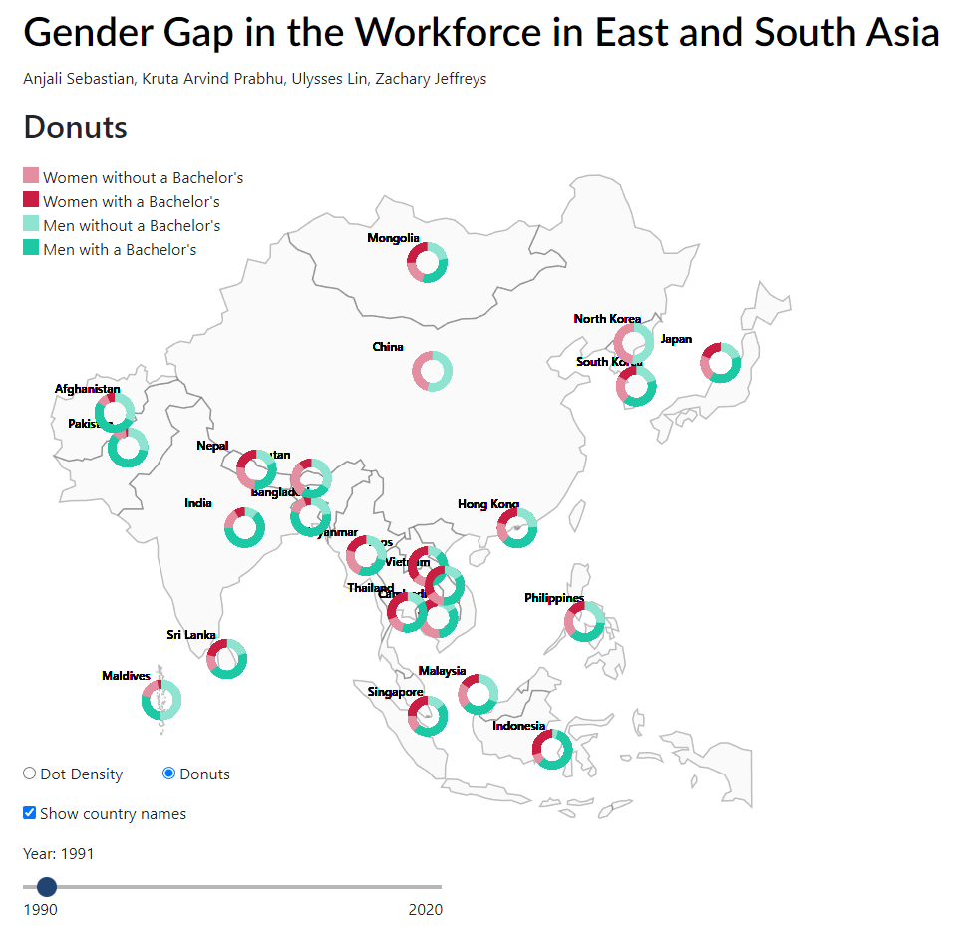
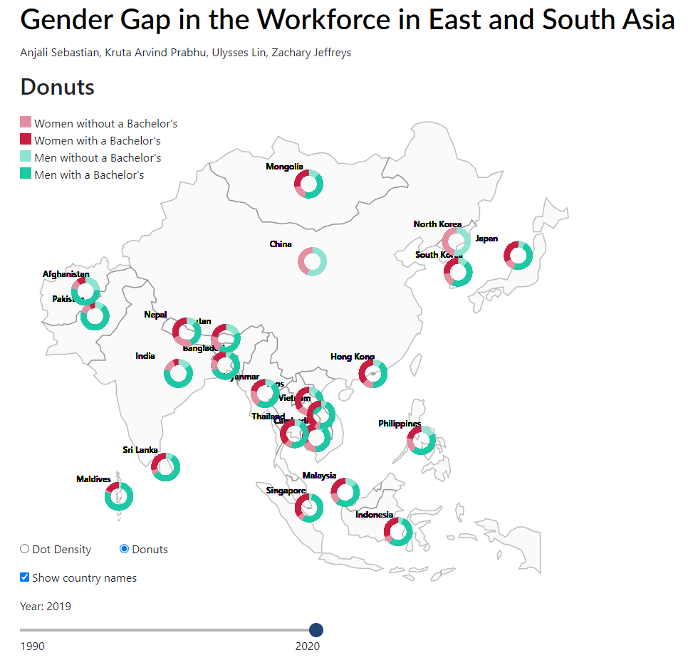
The Donut Map
Map displaying all Asian countries with the employment for males and females with a degree in the years 1991 and 2019 using donut charts

Slide 14
Design Rationale (2/3)
Map is starting point for exploration.
Waffle chart: A tooltip to represent the division of workforce by sectors. More integrated and keeps the visual compact.
Why waffle chart? Easy to understand and intuitive.
We have used the Gestalt principle of figure-ground to show the waffle tooltip.
Forecasting participation ratio for next 20 years. A separate line chart that shows when will equity be reached. 95% Confidence Interval.

Slide 15
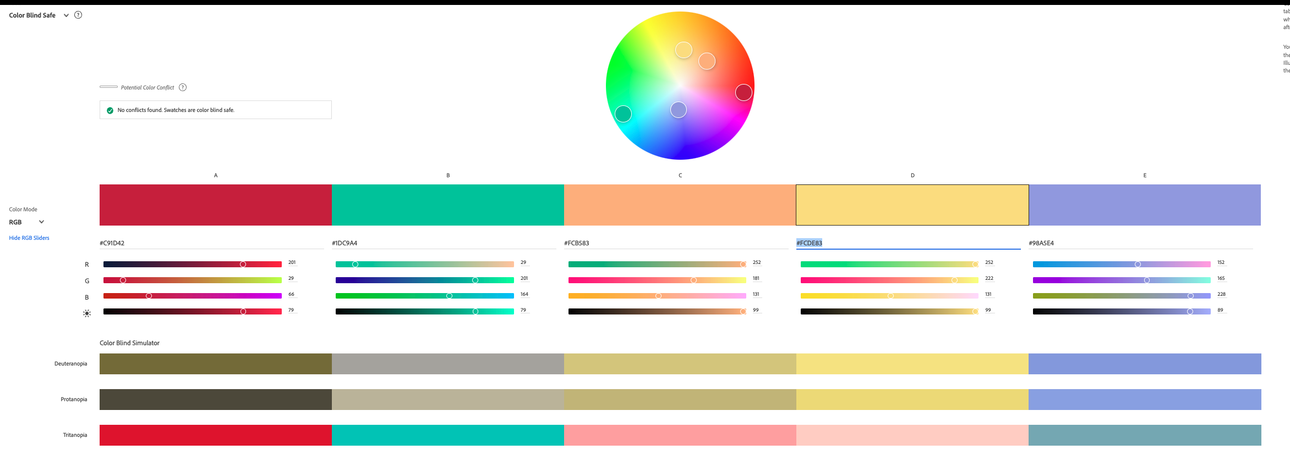
Design Rationale(3/3)
We have used a color scheme from The Economist as we felt that this would indicate a sense of seriousness.
In Dot Map we have, used hue change to represent Male-Female (Nominal) and value change to represent workers with higher education or not (Ordinal)
We have checked the color scheme for color-blind users using Color-blindness.com so that the visualizations could be viewed by everyone.
We have also checked the 5 main colors used on Adobe Color for color blindness visibility

Slide 16
General Insights
Taiwan is not a country according to the World Bank.
China has not reported any numbers on its percentage of educated workforce.
High-income countries like South Korea and Japan are heavily service-based. Middle and lower-income countries are more agriculture-based e.g., India, Laos, and Vietnam.
Most countries show a trend away from the agriculture sector.
Most Equitable countries - Vietnam and Laos
Some countries are close to achieving equity soon and are rising – Japan and South Korea
Some countries are showing a negative trend – India, and China

Slide 17
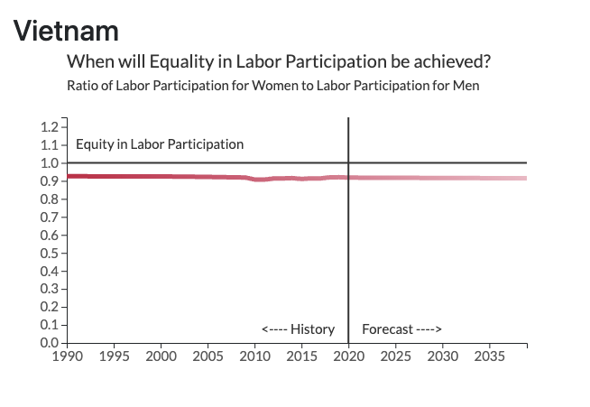
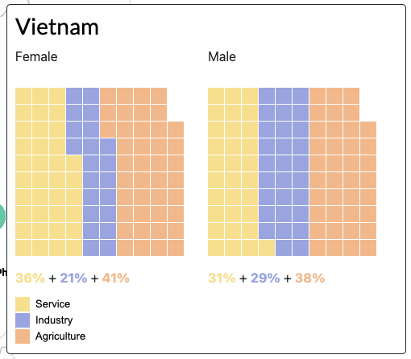
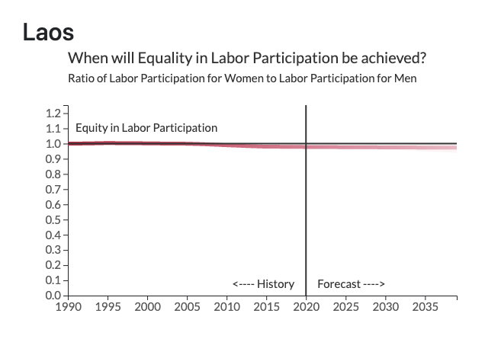
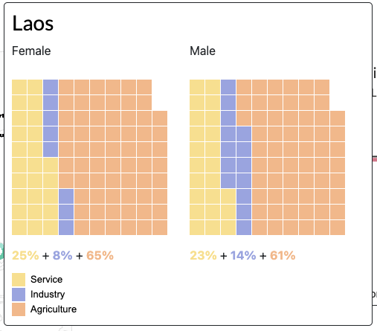
"Women hold up half the sky" Case Study: Laos and Vietnam
High Income does not always mean equal workforce participation:
Laos and Vietnam have one of the highest workforce participation rates for women.
Workforce participation ratio is above 0.9 and sometimes higher than 1 for Laos
For Laos it may be higher than optimal.
Women work in Agriculture and Industry

Slide 18
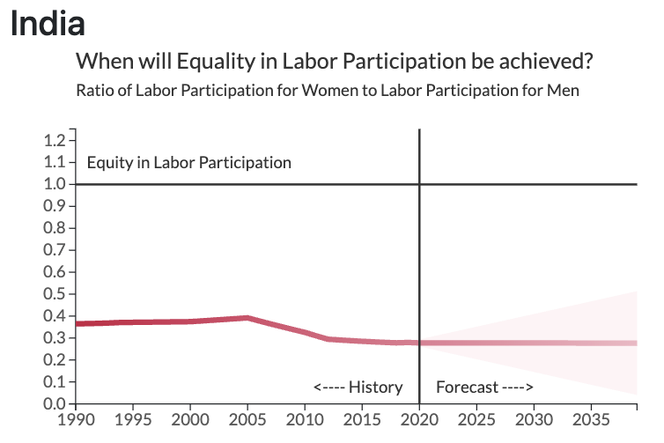
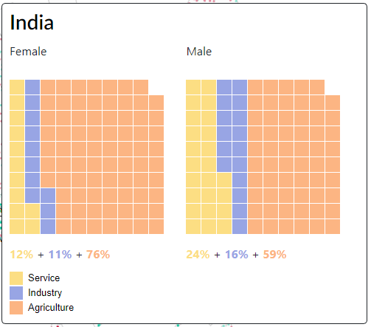
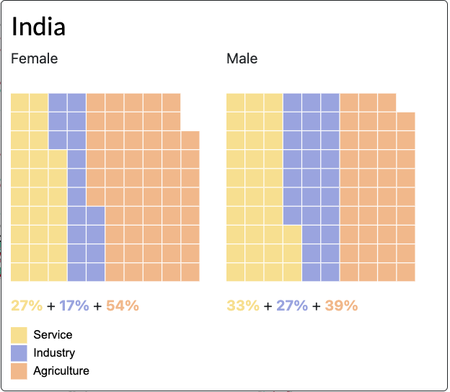
Cultural Barriers Case Study: India
Almost as if there is an invisible social barrier at 0.4
Country is moving away from agriculture. Women were employed significantly in the agriculture sector in the 1990s
Incomes are rising but the cultural barrier is telling women they don’t need to work
We have enough money - Now you don't need to work - Stay home and take care of the kids
Need for external intervention. Significant economic potential is lost
China is also showing a similar downward trend
Trend from 1991 to 2019

Slide 19
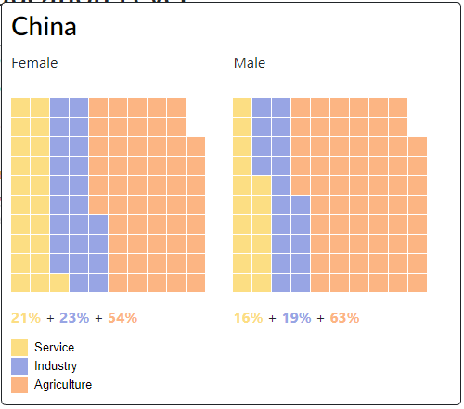
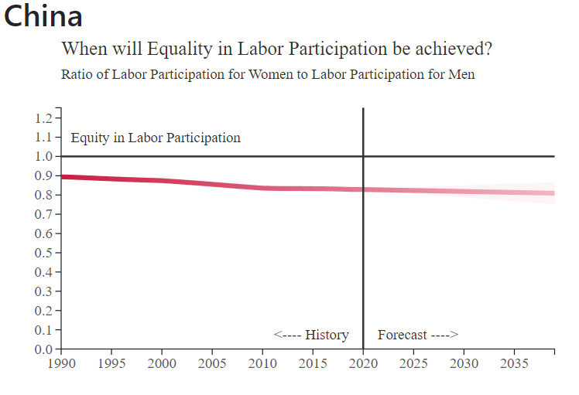
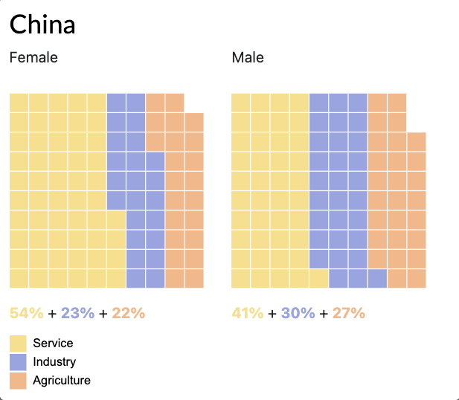
China's Declining Participation Ratio
1990
Regression chart showing the past and future trends in the employment for females in China
2019

Slide 20
Future Work
1
2
3
4
Visualize the number of women in Technology Sector
Visualize the future number of men and women in the technology Field
Analysis of economic loss for a country due to unequal workforce participation
Identify specific cultural barriers that hinder equality

Slide 21
References
Economist Scheme: https://design-system.economist.com/foundations/colour/palettes#brand
Code Resources
https://d3-graph-gallery.com/graph/line_filter.html
https://d3-graph-gallery.com/graph/line_confidence_interval.html
https://d3-graph-gallery.com/graph/line_color_gradient_svg.html
https://bl.ocks.org/Qizly/8f6ba236b79d9bb03a80
http://bl.ocks.org/XavierGimenez/8070956

Slide 22
Thank You!

Slide 23
Appendix 1: Sector Division India and China 1991
Division by sectors for China and India in the year 1991

